Slide 1
The Effect of Sprawl Development on Food Access in the United States
Stephanie Schauder
Department of Economics
Cornell University
Notes:
Hello! My name is Stephanie Schauder, I am a PhD candidate at Cornell specializing in agricultural and health economics. My job market paper is titled the effect of Sprawl Development on Food Access in the United States

Slide 2
Motivation
“An advanced city is not a place where the poor move about in cars, rather it’s where even the rich use public transportation”
-Enrique Peñalosa (Former mayor of Bogotá, Colombia)
Notes:
The former mayor of bogota, Enrique penalosa, said that ”an advanced city is not a place where the poor move about in cars, but where even the rich use public transportation.” In this paper I investigate how a car dependent transportation pattern vs. a public transit and walking transportation pattern affects access to services.

Slide 3
Transportation in America
Average family spends $9,737 a year on transportation (Consumer Expenditure Survey, 2017)
Not owning a car severely restricts access to services in most metropolitan areas
Notes:
The average American household spends almost 10,000 dollars per year on transportation. However, not owning a car severely restricts access to services for people in many locations. In this paper I investigate how a car dependent transportation pattern affects access to grocery stores. This is convenient because there is a lot of data on grocery store accessibility thanks to food access research. However, my model could really be applied to access to any service. Whether it be the ability to get to the doctor, or a job, or to vote, these things are all easier in less car-dependent areas

Slide 4
Grocery Landscape
Sprawl development is characterized by low population density and high car dependence
Sprawl in the U.S. is a result of the interstate highway system (Baum-Snow, 2007)
Sprawl changed the grocery shopping landscape
Grocery stores per zip code in low-income areas decreased from 3.24 to 0.71 (Thibodeaux, 2016)
Notes:
Sprawl development in the united states is a result of the interstate highway system. This is because as the interstate highway system reduced transportation time and cost significantly and people could live further from the center city, thus cities built out rather than up

Slide 5
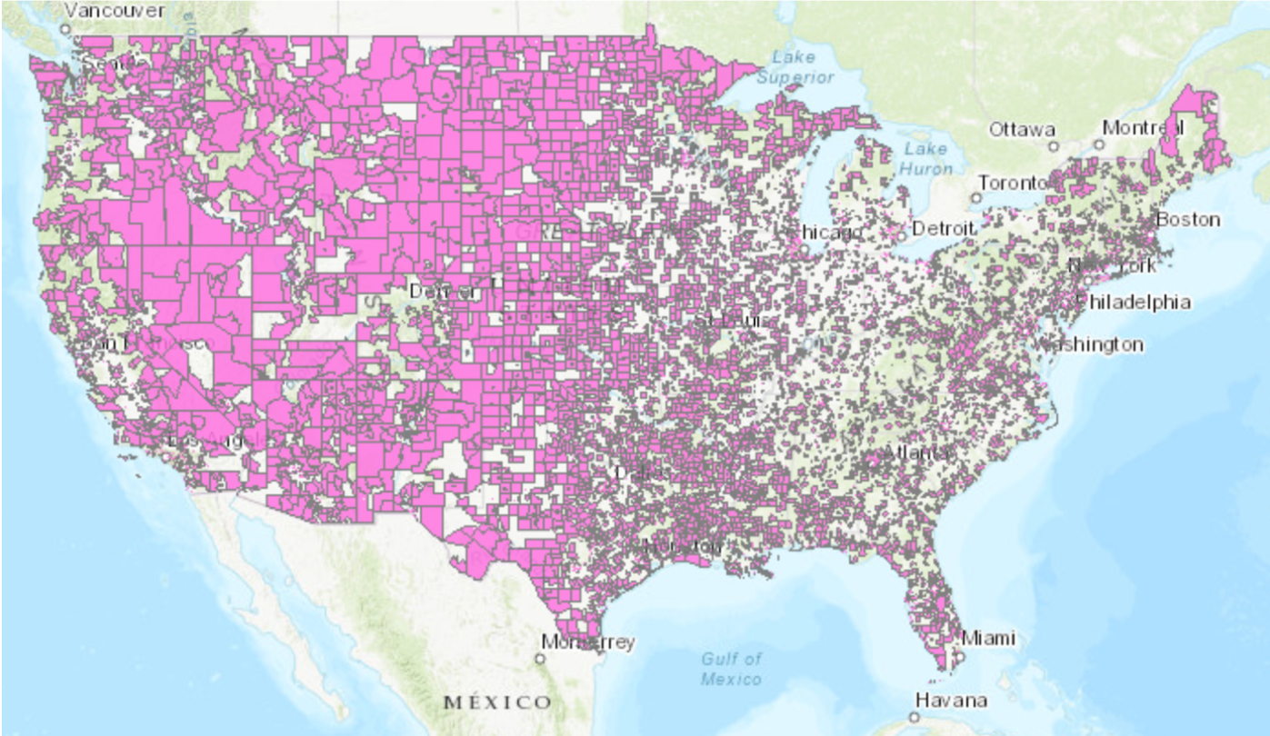
Food Access
Notes:
The US department of agriculture defines an urban census tract as having low access to food if:
At least 500 people or if at least 33 percent of people in a given Census tract live further than a mile away from a grocery store
This map is part of the Department of Agriculture food access research atlas. The pink sections show census tracts that have low food access
a significant number (at least 500 people) or share (at least 33 percent) of the population is greater than 1.0 mile from the nearest supermarket, supercenter, or large grocery store

Slide 6
Background: Food Access
People living closer to fresh food eat more fresh food (Bodor et al., 2008; Zenk et al., 2009)
Those with good food access have lower rates of obesity, kidney disease, and hypertension (Michimi and Wimberly, 2010; Lopez, 2007; Schafft et al., 2009; Suarez et al., 2015)
Growing up in a food environment where high fat/rewarding foods are prevalent can shape dietary behaviors for years to come (Teegarden et al., 2009)
Notes:
Now some background information on food access. Research shows that people living closer to fresh food eat more fresh food. Studies also show that those with good food access have lower rates of diet related diseases such as obesity, kidney disease, and hypertention. So it seems like we should just build more grocery stores right? Well actually studies show that improving food access through building more grocery stores or moving to a different environment actually only translates to limited improvements in nutrition

Slide 7
Research Question and Objectives
How does sprawl development affect access to grocery stores?
I develop a theoretical model and agent-based simulation
The simulation suggests sprawl development results in fewer grocery stores
I test this hypothesis with an instrumental variables model
Notes:
Therefore my question is, how does sprawl development. Objective explicitly

Slide 8
Preview of Results
The IV model shows sprawl development and car dependence are associated with lower food access though the magnitude is small

Slide 9
Literature Review
Residential segregation negatively affects food access (Blok et al., 2015)
When income segregation is reduced, inexpensive but healthy food stores move into low-income neighborhoods (Auchincloss et al., 2011)
Increasing income and providing transportation options would improve food access (Koh et al., 2019)
The most effective way to increase fruit and vegetable consumption is to increase grocery shopping frequency (Widener et al. 2013)
Notes:
Only a few studies have tried to understand the formation of food deserts and they are predominantly agent-based models
Agent-based modeling has been identified as an effective way to study food access (Li et al., 2016).
Agent-based models are useful for understanding the implications of changes to the food environment
because they help policy makers understand assumptions about interventions and explore the effects of
Blok et al. (2015) and Auchincloss et al. (2011) both use agent-based frameworks to look at the effects of residential segregation on food access.
Those who use public transit, walked, or biked had more frequent and smaller grocery trips than those who used cars (Jiao et al., 2016)

Slide 10
Contribution
There is a lack of economics research investigating why food access problems arise in the first place (Bitler and Haider, 2011)
Build off the agent-based modeling literature by building a model with heterogeneous transportation costs
I test the implications of the simulation with a reduced form model to attempt to show causality
Use an instrument that could be applied in future research on food access
Notes:
There is a lack of economics literature in particular investigating how food access problems arise
My research will build off of the agent-based models that we do have with the added benefit that I will test the conclusions of my agent-based model with real world data
I also contribute to the discussion an instrument that could be used in future research

Slide 11
Agent-Based Simulation
Goal: Understand if the car dependence of a city could theoretically affect the number of grocery stores
Simulate grocery store environment formation in 3,140 of the 3,142 U.S. counties
I use the percentage of people who drive in each county as an indicator of sprawl (Burchell, 1998)
Outcome is “Number of Grocery Stores” and “Grocery Stores per 1,000 People” (GSPP)
Notes:
Simulate 3,140 of the 3,142 U.S. counties two were excluded for missing data. Reference, references

Slide 12
Notes:
My data for the agent-based model come from the department of agriculture economic research service, and the American community survey

Slide 13
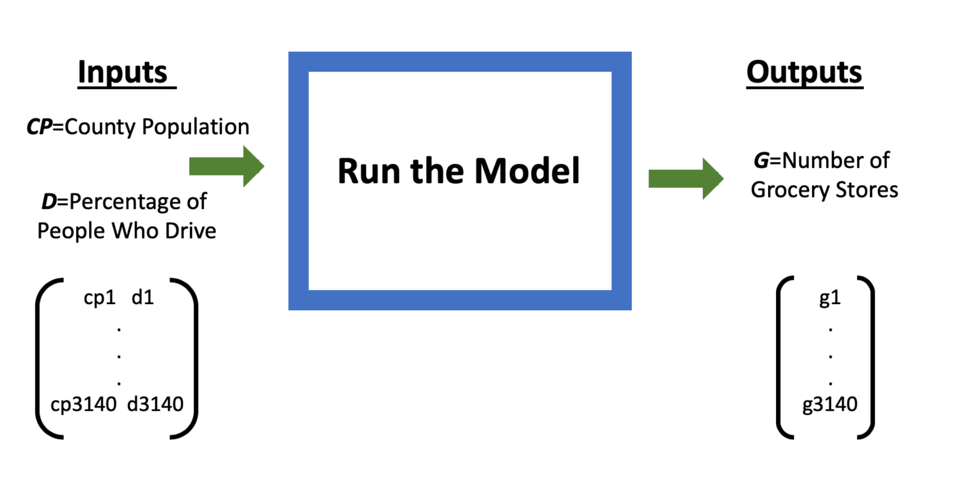
Notes:
Here is a demonstration of how the simulation works. The inputs are..
The outputs are…

Slide 14
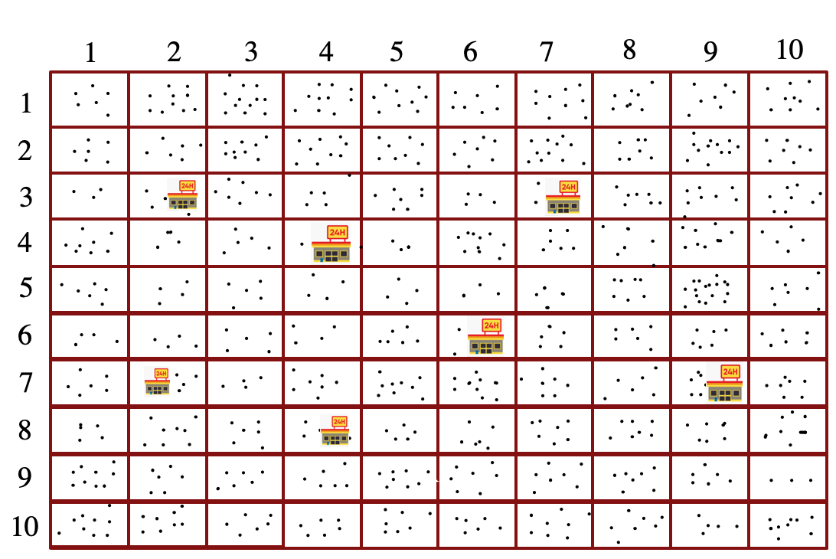
Setup
Population and percent of drivers establish baseline conditions
People and stores cannot move

Slide 15
Consumer Utility
$U_{it}^{∗}=\max_{g∈G}\left[\max_{F_{itg}, { X}_{itg}∈[0, ∞)}⁡\left[{\left(F_{itg}\right)}^{f}{\left(X_{itg}\right)}^{1−f}−K_{ig}\right]\right]$
Subject to:
$I=P_{gt}F_{itg}+X_{itg}$
Where:
$$K_{ig}=\left\{\begin{aligned}Y∗distance_{ig} \\ W ∗\left(Z^{distance_{ig}}\right) \end{aligned}{ \text{if} \text{the} \text{consumer} \text{drives}\text{,} \atop \text{if} \text{the} \text{consumer} \text{walks}\text{.}}\right.$$
$$i = \text{individual} i$$
$$t = \text{time}$$
$$g= \text{grocery} \text{store} g$$
$$f= \text{percentage} \text{of} \text{income}$$
$\text{spent} \text{on} \text{food}$
$$F= \text{Quantity} \text{of} \text{food}$$
$$X= \text{All} \text{other} \text{goods}$$
$$G= \text{Set} \text{of} \text{all} \text{grocery} \text{stores}$$
$$I = \text{Income}$$
$$P= \text{Price} \text{of} \text{food}$$
$$distance_{ig} = \text{Euclidean} \text{distance}$$
$\text{between} i \text{and} g$
$$Y, W, \text{and} Z = \text{parameters}$$

Slide 16
Maximizing Utility
$$F_{i}^{∗}=\frac{f∗I}{P_{g∗}}$$
Where g* is the grocery
store the agent chooses

Slide 17
Firm Profit Function
$$∏ = \text{Profit}$$
$$TR = \text{Total} \text{Revenue}$$
$$TC = \text{Total} \text{Cost}$$
$$P = \text{Price}$$
$$F = \text{Quantity} \text{of} \text{Food}$$
$$MC = \text{Marginal} \text{Cost}$$
$$FC = \text{Fixed} \text{Cost}$$
$$AVC = \text{Average} \text{Variable}$$
$$\text{Cost}$$
$$E = \text{Additional} \text{profit} \text{to}$$
$$\text{attract} \text{competition}$$
$$Π_{tg}={TR}_{tg}−{TC}_{tg}$$
$${TC}_{tg}=AVC∗F_{tg}+FC$$
$${TR}_{tg}=P_{tg}∗F_{tg}$$
Exit rule:
$$Π_{t=n}<0$$
Entry rule:
$$Π_{t=n}≥E$$

Slide 18
Parameterization
Consumers
$$I = \$59,000$$
$$f = 0.15$$
$$W = 0.58$$
$$Y = 0.67$$
$$Z = 39.5$$
Grocery Stores
$$MC= \$20$$
$$FC =\$3,000,000$$
$$E = \$3,000,000$$
Notes:
FC and E affect the average number of grocery stores in the model but they do not affect which counties have more grocery stores comparatively because they are the same for every county
I = $59,000 which is the average income of the counties in the model
f = .15, to match the amount of income the average family spends on food (Tuttle and Kuhns, 2016).
MC = $20, this is arbitrary because a unit of food is arbitrary
Consumers will always spend 15% of income on food
FC and the additional amount necessary to make an economic profit, E, where calibrated minimize squared error in predicted grocery stores using a 5% sample of counties. These values were:
FC = $3,000,000 and E = $3,000,000
Calibrated to minimize squared error in predicted grocery stores using a 5% sample of counties
This calibration only affects scale and not dispersion of grocery store numbers
FC and the additional amount necessary to make an economic profit, E,

Slide 19
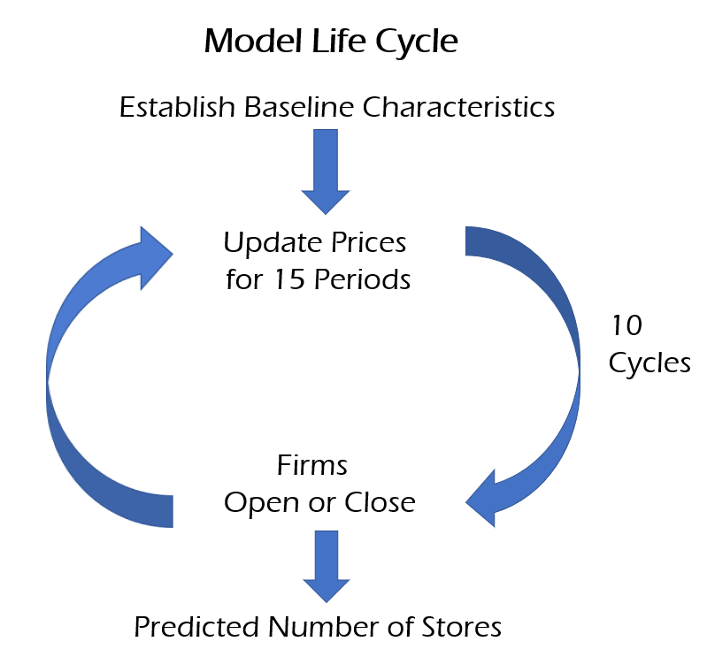
Notes:
Here is visual showing what happens inside the model. The population and commuting patterns are used to establish baseline characteristics for a particular county. Once the population and number of grocery stores have been determined, the people are dispersed randomly in the 10 X10 grid. The grocery stores also receive a random position. Then prices are set to marginal cost, and consumers decide which grocery store will maximize their utility function, and how much food they will purchase there. Then grocery stores have the opportunity to update prices to find the profit maximizing price. This of course depends on the prices of other firms. When firms update prices they use last period’s prices for their calculations. Firms update prices for 15 periods. At the end of 15 periods if a firm is making an economic profit, it attracts a competitor. If it is making a negative accounting profit, it ”dies” or is removed from the model. New competitors do an exhaustive search to find the profit maximizing location. Then the revised set of firms goes back and updates prices for 15 periods. This cycle happens 10 times. At the end I observe the predicted number of grocery stores in the county.

Slide 20
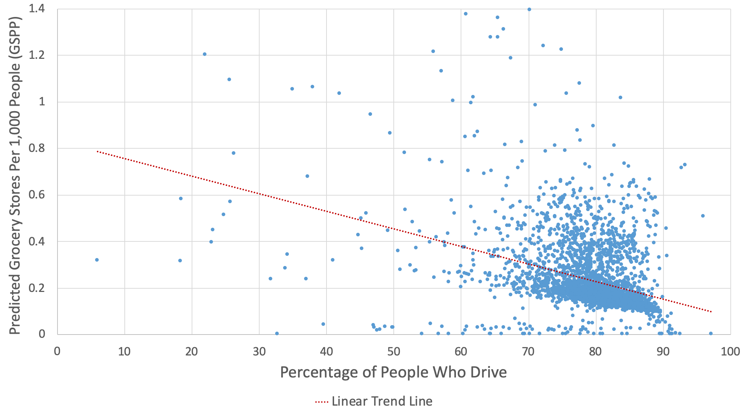
Notes:
This graph shows the relationship between the predicted number of stores and the percentage of people who commute by driving. As you can see, in counties where more people drive there are fewer grocery stores.

Slide 21
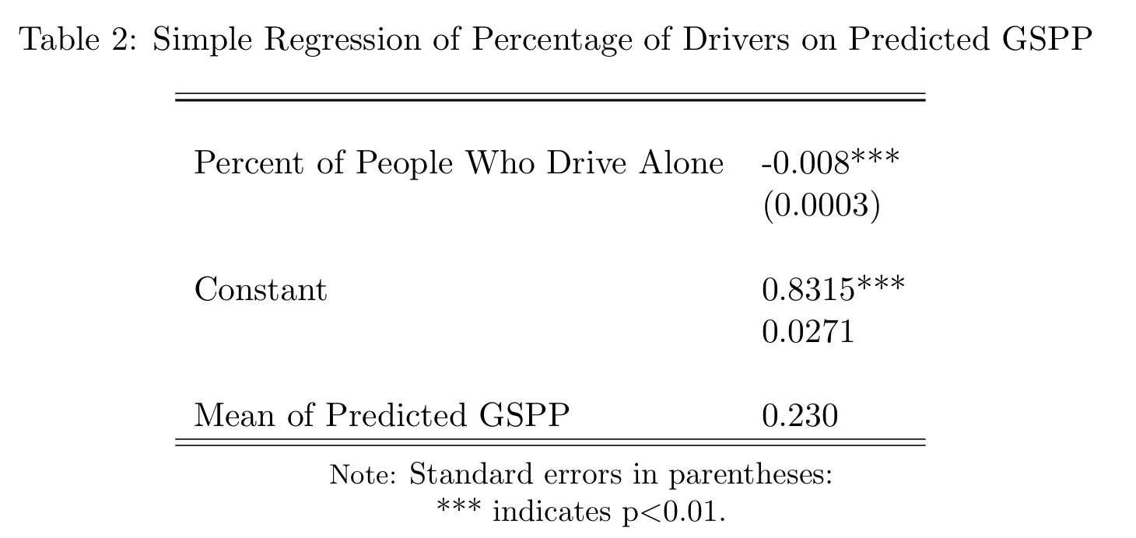
Notes:
This table shows the regression which yields the best fit line above.
A 1 percentage point increase in the percentage of people who drive causes a 0.008 reduction in GSPP which is 3.5 percent of the mean

Slide 22
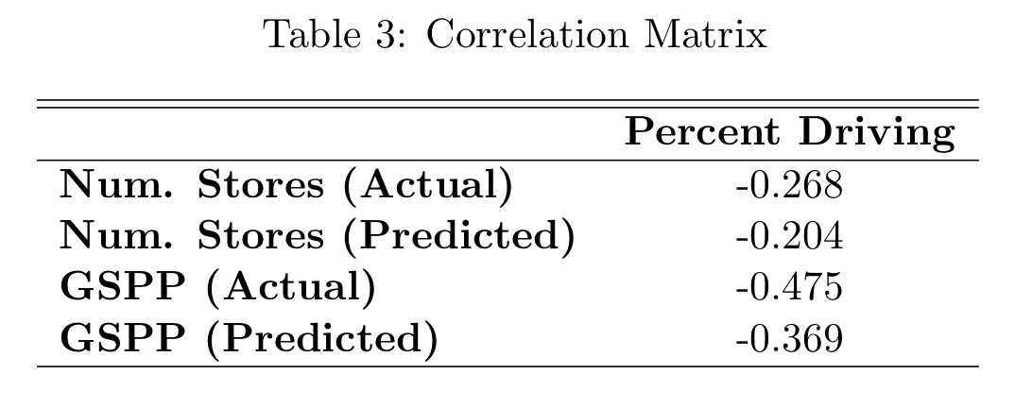
Notes:
This table shows the correlations between the quantity of grocery stores and the percent of people drive. As the graph suggests there is a negative correlation. What sticks out to me is that there is actually a stronger association in the real data than in the predicted data. This suggest to me that there is some endogeneity, and that sprawl is associated with food access for reasons other than those generated by the model.

Slide 23
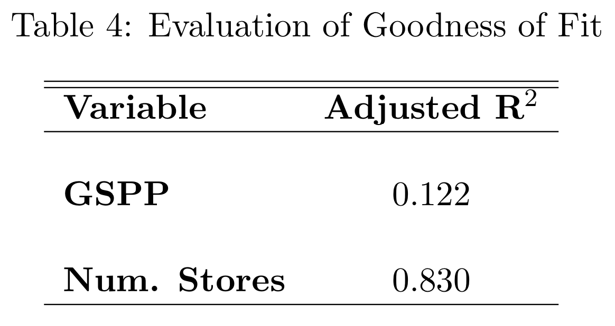
Notes:
This table shows how well the simulation data predicts the real data. The simulation is able to explain 83\% of the difference in the number of stores, however it can only explain 12\% of the variation in GSPP. GSPP controls for population so this indicates that the majority of the explanatory power of the model comes from population but commuting patterns are able to explain 12% of the variation

Slide 24
Simulation Results
When more people drive, a city has fewer grocery stores because there is less demand for local grocery stores
Stores can differentiate by location allowing more firms to populate the model
The simulation can explain 83% of the variation in the number of grocery stores, but most of the explanatory power comes from population
Notes:
Given our assumptions, the model predicts that a larger percentage of drivers leads to fewer grocery stores
This is causal in the world of the simulation
This model uses as little information as possible
Simulation explains 83% of the variation in the number of grocery stores.
Most of the explanatory power comes from population
12% comes from transportation patterns
Affect on prices will have to be explored further

Slide 25
Instrumental Variables (IV) Model
The agent-based model suggests that sprawl and car dependence lead to a reduction in grocery stores
I test this with an IV model
Would like to regress indicators of sprawl/car dependence on food access but sprawl is endogenous
Need to find an exogenous reason why some cities would develop in a sprawling pattern, but others would not
Notes:
Now I am going to discuss the instrumental variables model. The agent-based model suggests that sprawl development and car dependence lead to a reduction in grocery stores.
I test this hypothesis with an instrumental Variables model
I would like to regress indicators of car dependence on food access but sprawl is endogenous

Slide 26
The Ideal Randomized Control Trial
Two groups of cities the same in every way
Developers told to build car dependent cities or non-sprawling cities
In 50 years, assess food access in both groups
Notes:
To think about what would be a good instrument, let’s envision what would make an ideal randomized control trial. Suppose there were two groups of indentical cities. And I control the city planners for both groups. Then I would tell one group to develop in a car-dependent sprawling manner, and I would tell the other group to build in a dense walkable manner. And in 50 year, I would look at where the grocery stores are and assess which city has better food access. Clearly this would never happen in the real world. Therefore, I need to find an instrument which exploits an exogenous reason why one city might in a car-dependent manner and other city won’t

Slide 27
Identifying Assumptions
The instrument is valid if:
Correlated with current measures of car dependence
Affects food access only through its effect on car dependence
No defiers (monotonicity)
Notes:
argue

Slide 28
The Instrument
1947 planned highway rays is an exogenous source of variation (Baum-Snow 2007)
Goals of the 1947 plan were to: connect major cities, improve shipment of goods, and transport the military
Proximity to other major cities a determining factor
Highways plans later took commuting and congestion into account
Notes:
The instrument I choose is 1947 planned highway rays. And I give credit for this idea to Baum-Snow who used this instrument, when trying to understand if the construction of the interstate highway system caused sprawl development
Why does this make a good instrument?
Well the goals of the 1947 plan were to connect major cities, improve shipment of goods, and transport the military
Whether a city received more highways in this plan was largely a function of its proximity to other major cities
Why is this important? Well actual highways are pretty endogenous because future highway plans took things like density and local commuting into account, and in 1960 highways were protested and in some cases not built
As you might imagine the most successful protestors were white well educated communities

Slide 29
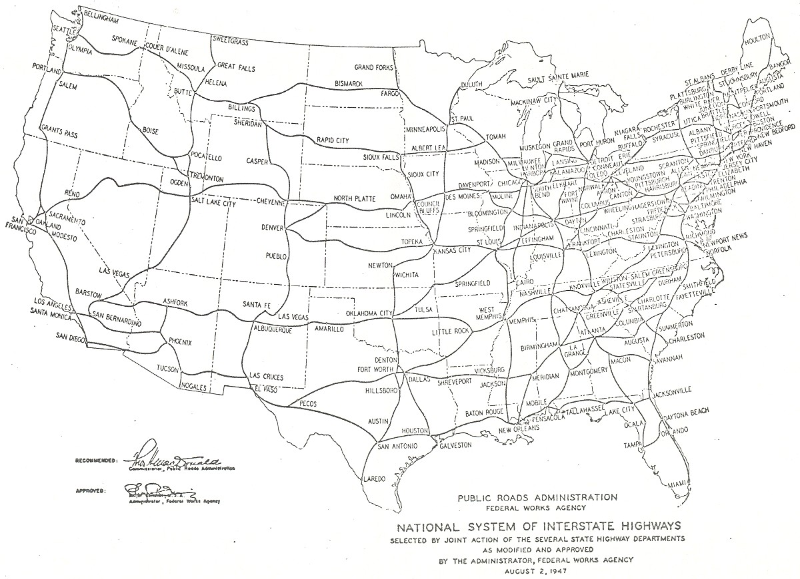
1947
Planned
Highway
Map
Notes:
The instrument that I choose is planned highways from 1947
Here is a map of the 1947 plan. I use baum-snow’s data on planned highway rays. A highway ray is a segment of highway emanating from a city. If a highway runs through a city this counts as two rays. For example lets look at at Albuquerque, NM. I have highlighted each of the four highway rays in a different color. So what Baum-Snow did, is counted all the highway rays for every city in this plan.

Slide 30
Identifying Assumptions Revisited
1947 highway rays is a valid instrument if:
Correlated with current measures of car dependence
Affects food access only through its effect on car dependence
No defiers (monotonicity)
Notes:
Let’s look at these assumptions again:
Highway rays should be correlated car dependence because I expect that cities that were nudged to have more highways would be likely to have have more highways and therefore more sprawl and reliance on cars
I can test this assumptions with the first stage F test and I will discuss this below
I can’t test the next two assumptions, but I will give you my reasoning:
1947 planned highways were distributed to connect cities as I mentioned, and not taking individual characteristics of cities into account. Therefore this original highway plan should not affect food access
The monotonicity assumption means that the nudge given my the highway plan should affect all cities either not at all or in the same direction (in this case positively). What this means is that if I a particular city was nudged by the highway plan to have more highways, the city should not for some reason as a result of this nudge decide to have fewer highways than it would have had in the absence of this nudge by the 1947 highway plan. I think in this case this assumption is reasonable.

Slide 31
First Stage
$$\hat{Sprawl}= α_{0}+α_{1}PlannedRays+α_{2}X+μ$$
Second Stage
$$Outcome= β_{0}+β_{1}\hat{Sprawl}+β_{2}X+ε$$
$$PlannedRays = \text{1947 }\text{planned} \text{highway} \text{rays}$$
$$Sprawl = \text{One} \text{of} \text{the} \text{four} \text{indicators} \text{of} \text{car} \text{dependence}$$
$$X = \text{A} \text{vector} \text{of} \text{control} \text{variables}$$
$$Outcome = \text{Indicator} \text{of} \text{food} \text{access}$$
Notes:
Here is my model
-In the first stage I used planned rays to predict sprawl
-In the second stage I estimate the effect of sprawl on food access

Slide 32
Data
Metropolitan Statistical Area level data
Highway rays are from Baum-Snow (2007)
Food access indicators are from the Food Access Research Atlas (Ver Ploeg et al., 2017)
Commuting patterns and control variables are from the American Community Survey
Notes:
My data consist of highway rays, both planned and current
Indicators of food access
communities patterns
And control variables

Slide 33
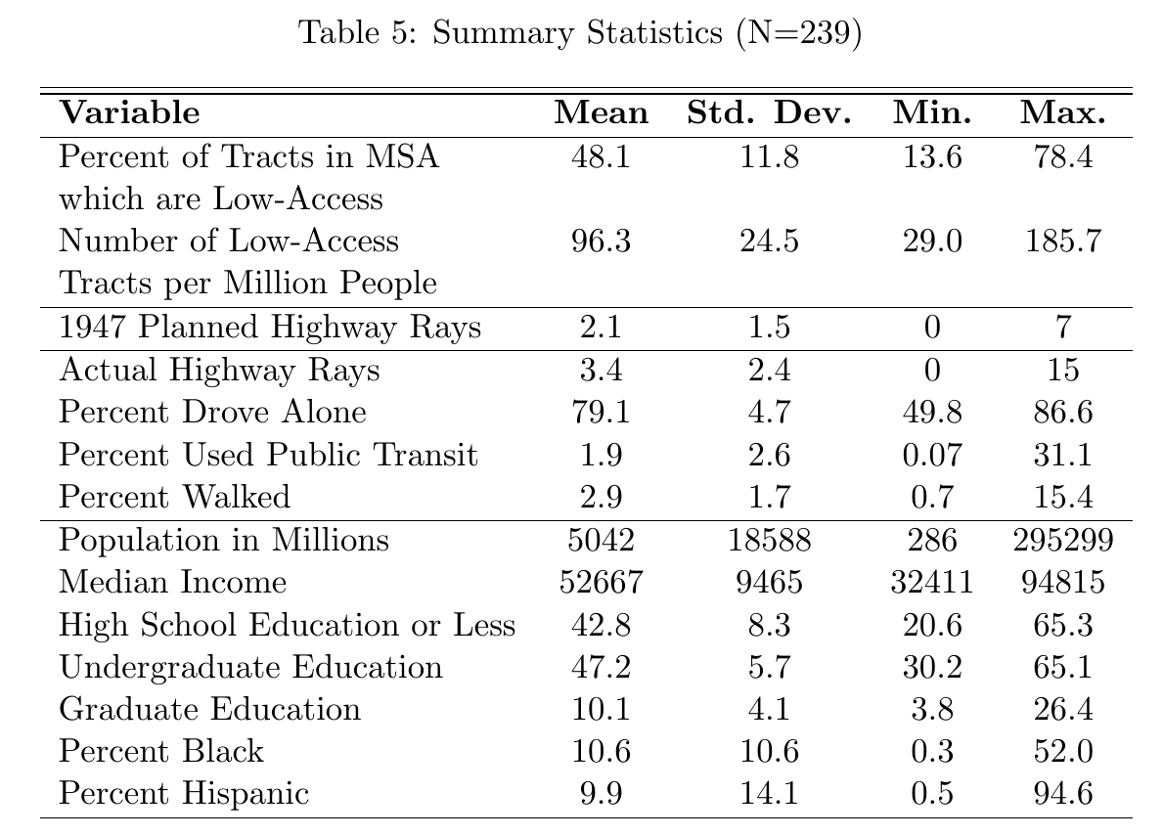
Notes:
Outcome
Instrument
Explanatory
Control
A couple of things to point out:
The number of people who commute by driving alone varies from 50% to 85%
The number of people that use transit or walk also varies quite a bit although the mean is low

Slide 34
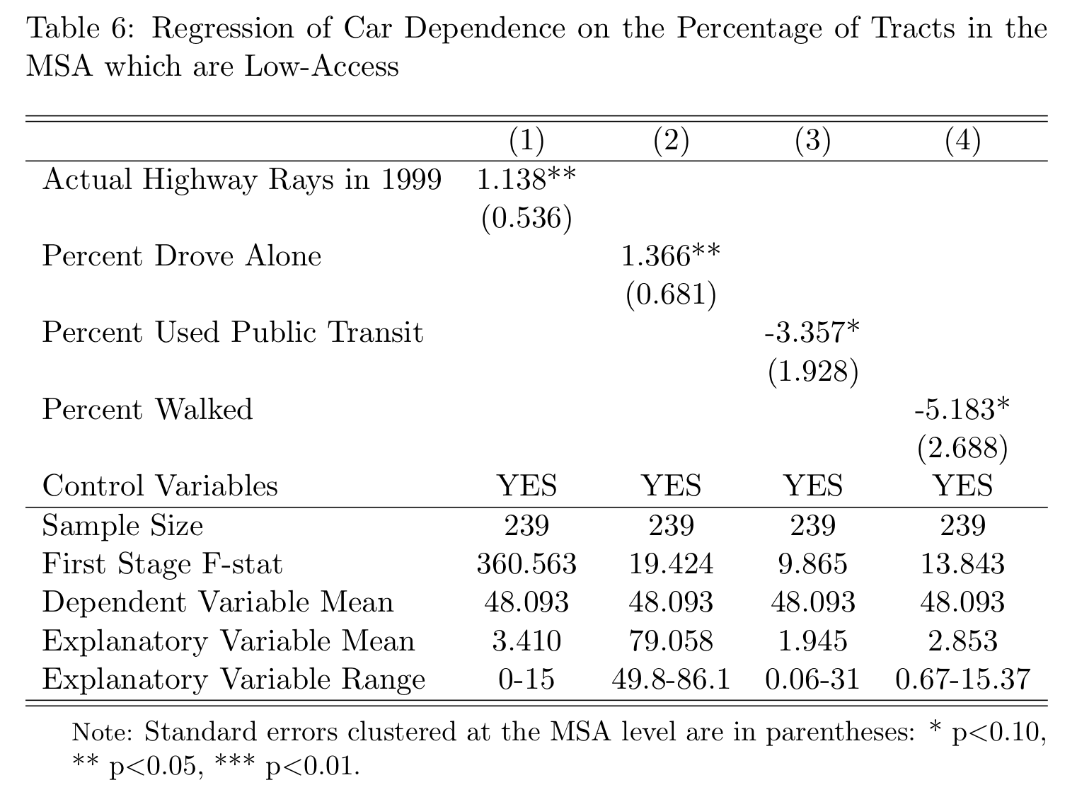
Notes:
This second model essentially shows the same results, I included this other measure of food access just to check robustness across different outcome variables

Slide 35
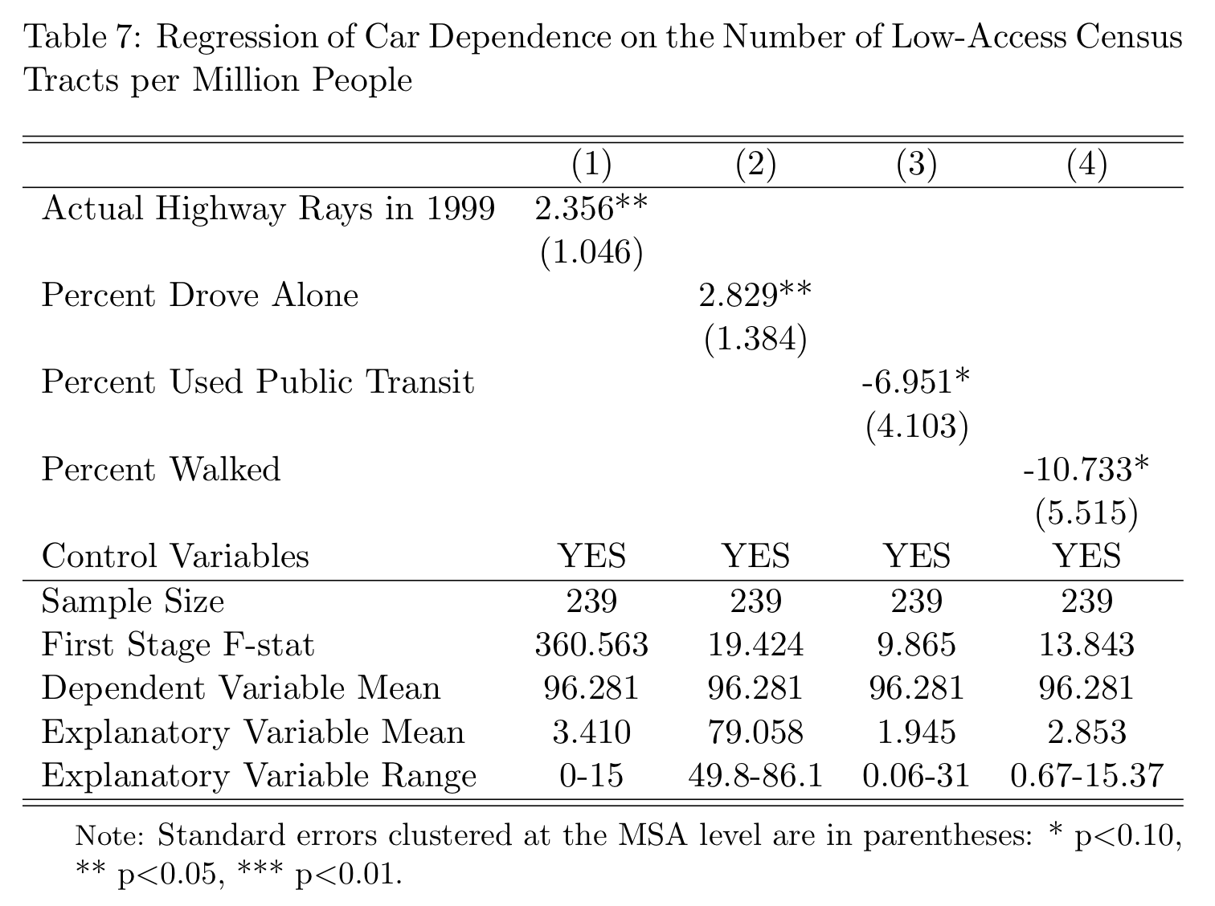
Notes:
This second model essentially shows the same results, I included this other measure of food access just to check robustness across different outcome variables

Slide 36
Results
Indicators of sprawl development are associated with lower food access
Driving
Walking
Transit
1.3 pp
-3.3 pp
-5.1 pp
1 pp increase in
causes a
change in the percentage
of census tracts in the MSA
which are low access
1 ray increase in
Highway
Rays
causes a
1.1 pp

Slide 37
Policy Implications
Could be used as part of a cost-benefit analysis for expanding public transit/walking/biking infrastructure
Inform development in cities that are not yet car-dependent
Could inform city and regional planners when making decisions about how a city should grow
Price effects still need to be explored

Slide 38
Limitations and Future Work
The agent-based simulation presents a mechanism but cannot show causality
This mechanism is tested with the IV model
It would be helpful to find or create a panel dataset to analyze the development of the highway system and its effects on food access over time to exploit additional variation
Don’t have price data

Slide 39
Conclusion
A sprawl development pattern may lead to worse food access over time
A non-car-dependent development pattern is associated with better food access because consumers have increased demand for local stores

Slide 40
Stephanie Schauder
sas648@cornell.edu
Department of Economics
Cornell University
Notes:
Hello! My name is Stephanie Schauder, I am a PhD candidate at Cornell specializing in agricultural and health economics. My job market paper is titled the effect of Sprawl Development on Food Access in the United States

Slide 44
Food Access Controversy
Building more grocery stores translates to limited improvements in nutrition (Dubowitz et al., 2015; Cummins et al., 2014; Handbury et al., 2015; Lee, 2012, etc.)
This discrepancy underscores the necessity of understanding how food deserts form (supply vs. demand)
Change is slow - Growing up in a food environment where high fat/rewarding foods are prevalent can shape dietary behaviors for years to come (Teegarden et al., 2009)
Access to healthy food is a necessary but not sufficient condition for improving nutrition (Hammond et al., 2012; Wedick et al., 2015)
Notes:
At first this might seem strange that building more grocery stores doesn’t necessarily translate to better nutrition. This is indicates that there is a lack of demand, and underscores the importance of understanding why food deserts form. This is different than saying poor people don’t want fresh food. We got into this situation because demand did decrease, as I mentioned when there was the shift to shopping at stores further away from ones home. However, getting out of the situation is not so simple. Research shows that high fat rewarding food can shape dietary patterns for years to come come, so growing up in a food desert can cause people to develop preferences that take a long time to change. So maybe building more stores is not sufficient, but research shows that when there is access to healthy food, other nutritional interventions are far more effective. So both improving access and improving education are important. I am just focusing on the access piece in this work

Slide 48
Outline
Background
Literature Review/Contribution
Instrumental Variables Model
Simulation
Conclusion
Notes:
Here is an overview of what I will cover in my presentation. First I will present my research question, then I will give some background information on both food access and sprawl development. Next I will discuss relevant literature and my contribution to this literature. Then I will present my instrumental variables model, I will follow that with a simulation, and the conclusion.

Slide 49
1
2
3
4
5
6
7
8
9
10
1
2
3
4
5
6
7
8
9
vv
10
Notes:
This is an example county in the simulation. In this county the number of people is equal to the county population and are represented by the black dots. The grocery stores are the store icons you see here.

Slide 50
Setup
10 X 10 grid populated with consumers and grocery stores
Number of consumers = county population
Starting number of grocery stores = population*.00025
Consumers maximize utility
Transportation Effort
Grocery stores maximize profit
Notes:
Each county is a 10 X 10 grid populated with agents and grocery stores
Number of Agents = county population, starting number of grocery stores = population*.00025
Agents maximize utility, grocery stores maximize profit
“Transportation effort” is part of the utility function and depends on if the agent has a car

Slide 52
Notes:
Sprawl development, which is characterized by low population density and car dependence, has been blamed for everything from decreasing the city aesthetic to reducing lifespan

Slide 53
Research Question
How does Sprawl Development Affect Grocery Store Location and Food Access?
I Investigate this question with an instrumental variables model and a simulation
Notes:
My research question is How does Sprawl development affect grocery store location and food access?
Where urban sprawl is defined as a city characterized by low population density and high car dependence
And Food-access is defined as having ready access to healthy and affordable food

Slide 54
Background: Sprawl and Food Access
Sprawl development in the U.S. is the result of the interstate highway system (Baum-Snow, 2007)
Oligopoly power in the grocery retail market has increased significantly (Franklin and Cotterill, 1993)
The percentage of census tracts in London, Ontario with ready access to a grocery store declined from 45% to 18% as a result of sprawl development (Larsen and Gilliland, 2008)
Notes:
Sprawl development in the U.S. is the result of the interstate highway system (Baum-Snow, 2007)
Oligopoly power in the grocery retail market has increased significantly since the 1970's and in less populated areas, the industry is especially concentrated (Franklin and Cotterill, 1993)
One case study study of London, Ontario found that an increase in sprawl development and car-dependence between 1961 and 2005 was associated with a decline from 45% to 18% in the number of census tracts with "easy access" to a grocery store (Larsen and Gilliland, 2008).
At the national level, the number of grocery retailers per zip code in low-income
areas decreased from 3.24 to 0.71 between 1970 and 1990
grocery retailers in all zip codes decreased from 3.25 to 1.79 during the same time period (Thibodeaux, 2016).

Slide 55
Background: Implications of Food Access
People living closer to fresh food eat more fresh food (Bodor et al., 2008; Zenk et al., 2009)
Those with good food access have lower rates of obesity, kidney disease, and hypertension (Michimi and Wimberly, 2010; Lopez, 2007; Schafft et al., 2009; Suarez et al., 2015)
However, improving access to food only translates to limited improvements in nutrition (Dubowitz et al., 2015; Cummins et al., 2014; Handbury et al., 2015; Lee, 2012, etc.)
Underscores the necessity of understanding how food deserts form
Notes:
Now some background information on food access. Research shows that people living closer to fresh food eat more fresh food. Studies also show that those with good food access have lower rates of diet related diseases such as obesity, kidney disease, and hypertention. So it seems like we should just build more grocery stores right? Well actually studies show that improving food access through building more grocery stores or moving to a different environment actually only translates to limited improvements in nutrition

